Slide 1
Harmful Brain Activity Classification
Clayton Whitteberry

Slide 2
Project Overview
Multiclass Classification
6 Categories of Brain Activity
The goal is to classify seizures and other types of harmful brain activity based on EEG and spectrogram data that has been classified by experts.
The dataset is public from Kaggle. It is 26.4 GB and contains 28,463 files.
The focus for Capstone I is data preprocessing, feature extraction, and machine learning.
The focus for Capstone II is deep learning.

Slide 3
Data Overview
train.csv contains metadata for the training EEGs and spectrograms
EEG ID and sub ID, spectrogram ID and sub ID, offset seconds, expert classification
test.csv contains the same metadata for the testing EEG and spectrogram without the expert classification
train_eegs is a folder containing 17.3k parquets
Each parquet is a full EEG recording and can contain one or more 50 second sub EEGs
train_spectrograms is a folder containing 11.1k parquets
Each parquet is a full spectrogram and can contain one or more 10 minute sub spectrogram
test_eegs and test_spectrograms are folders containing a single 50 second EEG and 10 minute spectrogram

Slide 4
EEG Data
The 50 second sub EEGs are classified by experts
Dimensions are 10k rows by 20 columns
19 columns correspond to regions of the brain and the 20th column is for EKG data
EEG data is very noisy
Feature extraction required for machine learning

Slide 5
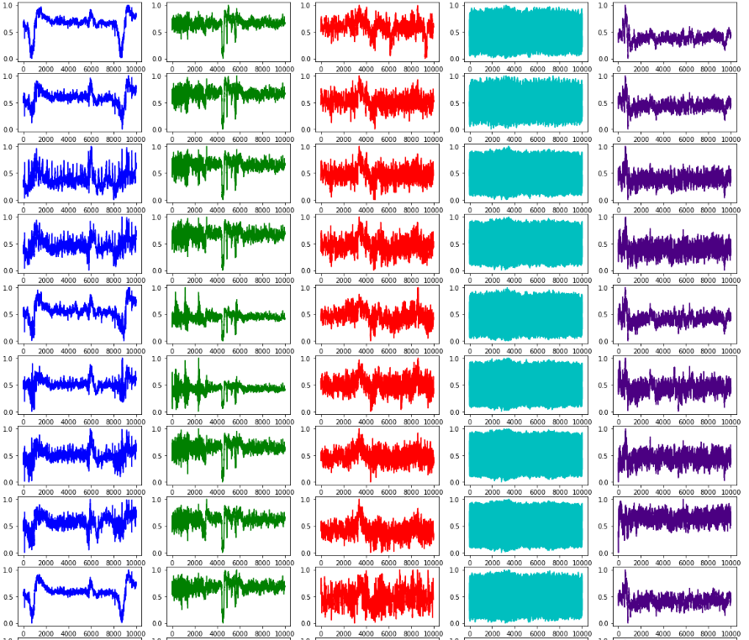
LRDA sub EEG Signals

Slide 6
Spectrogram Data
The 10 minute sub spectrograms are classified by experts
Dimensions are 300 rows by 401 columns
There is a column for time and 400 columns labeled the region of the EEG electrode followed by frequency in Hz

Slide 7
Data Preprocessing
Handling EEGs with universally extreme values
Noise Reduction
ICA, bandpass filtering, notch filtering
Dimensionality Reduction
PCA
Feature Engineering
time domain features (statistical features and Hjorth params)
frequency domain features (PSD and band power)
nonlinear features (approximate entropy and signal-to-noise ratio)
time-frequency domain features (wavelet transform)

Slide 8
Modeling and Evaluation
Ensemble approach using Random Forest
Kaggle metric: KL divergence between predicted probability and observed target
Common results for Deep Learning models were in the 0.5-0.7 range
Other metrics: precision, recall, f1-score
Deep Learning for Capstone II

Slide 9
References
Chaddad, A., Wu, Y., Kateb, R., & Bouridane, A. (2023). Electroencephalography Signal Processing: A Comprehensive Review and Analysis of Methods and Techniques. Sensors (Basel, Switzerland), 23(14), 6434. https://doi-org.ezproxy.uta.edu/10.3390/s23146434
Zhang, H., Zhou, Q. Q., Chen, H., Hu, X. Q., Li, W. G., Bai, Y., Han, J. X., Wang, Y., Liang, Z. H., Chen, D., Cong, F. Y., Yan, J. Q., & Li, X. L. (2023). The applied principles of EEG analysis methods in neuroscience and clinical neurology. Military Medical Research, 10(1), 67. https://doi-org.ezproxy.uta.edu/10.1186/s40779-023-00502-7
Murungi, N., Pham, M.V., Dai, X.C., & Qu, X. (2023). Empowering Computer Science Students in Electroencephalography (EEG) Analysis: A Review of Machine Learning Algorithms for EEG Datasets.

